Slide 1







2017
2017
Build an immutable application infrastructure with Nano Server, PowerShell DSC, and the
release pipeline
Visualising vSphere Performance
Ravikanth Chaganti
Luc Dekens

Slide 2
Agenda
Getting the data
Common techniques
Excel
MS Graph
Containers

Slide 3
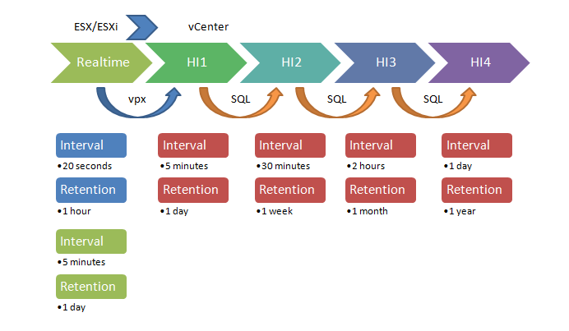
Getting the Data 1
PowerCLI contains Get-Stat cmdlet
Know how vSphere collects performance data!

Slide 4
Getting the Data 2
Realtime contains most info
Go for all metrics
Can produce a lot of data!
Check what is there. Don‘t assume!

Slide 5
$fileName = "D:\Stats\Stats-20170429-1605.csv"
$stats = Import-Csv -Path $fileName -UseCulture | Sort-Object -Property TimeStamp
Write-Host "Start : $(([DateTime]$stats[0].Timestamp).ToString('yyyy/MM/dd HH:mm'))"
Write-Host "End : $(([DateTime]$stats[-1].Timestamp).ToString('yyyy/MM/dd HH:mm'))"
Write-Host "Rows : $($stats.Count)"
Write-Host "Metrics : $(($stats | Group-Object -Property MetricId).Count)"
Write-Host "Instance: $(($stats | Group-Object -Property Instance).Count)"
Start : 2017-04-29 16:05
End : 2017-04-29 17:07
Rows : 589035
Metrics : 195
Instance: 133

Slide 6
Getting the Data 3
Do not forget a metric anymore!
Dump them all (if you have the free disk space)

Slide 7
$finish = Get-Date
$start = $finish.AddHours(-1)
$fileName = "D:\Stats\Stats-$($start.ToString('yyyyMMdd-HHmm')).csv"
$entity = @()
$entity += Get-VM -Name stress*
$entity += Get-VMHost -Name esx*
$stat = @()
$stat += Get-StatType -Entity $vm -Start $start
$stat += Get-StatType -Entity $esx -Start $start
$stats = Get-Stat -Entity $entity -Stat $stat -Start $start
$stats |
Export-Csv -Path $fileName -NoTypeInformation -UseCulture

Slide 8
Working with the data
Do not assume you are using the fastest method
Import-Csv is ok for occasional tasks
Repetitive, long running jobs can be done faster
StreamWriter
- You‘ll have to do more
Side note: Import-Csv ➔ properties are strings

Slide 9
# Import-Csv
$time1 = Measure-Command -Expression {
Import-Csv -Path $fileName -UseCulture |
where{[DateTime]$_.Timestamp -ge $start -and
[DateTime]$_.Timestamp -lt $finish} |
Export-Csv -Path $extract1 -NoTypeInformation -UseCulture
}
# ReadLine
$time2 = Measure-Command -Expression {
$in = [System.IO.File]::OpenText($fileName)
$out = New-Object System.IO.StreamWriter $extract2
$headers = $in.ReadLine()
$out.WriteLine($headers)
for(;;) {
$row = $in.ReadLine()
if (!$row) {
break
}
$columns = $row.Split(',').Replace('"','')
$ts = [DateTime]$columns[1]
if($ts -ge $start -and $ts -lt $finish){
$out.WriteLine($row)
}
}
$in.Close()
$out.Close()
}

Slide 10
File : D:\Stats\extract1.csv
Seconds : 159.5390259
Start : 2017-04-29 16:45
End : 2017-04-29 16:59
Rows : 147645
Metrics : 195
Instance: 133
File : D:\Stats\extract2.csv
Seconds : 64.1261056
Start : 2017-04-29 16:45
End : 2017-04-29 16:59
Rows : 147645
Metrics : 195
Instance: 133

Slide 11
PowerShell is fit for the Job
Use what is there
Select-Object
Sort-Object
Group-Object
Measure-Object

Slide 12
$extract = "D:\Stats\extract1.csv"
Import-Csv -Path $extract -UseCulture |
Group-Object -Property Entity |
Select Count,Name
Count Name
----- ----
7200 stress2
8685 stress5
7200 stress1
7200 stress3
7695 stress4
56025 esx1.local.lab
53640 esx2.local.lab

Slide 13

$extract = "D:\Stats\extract1.csv"
Import-Csv -Path $extract -UseCulture |
Group-Object -Property {$_.Timestamp.Minute} |
Select Count,Name
Count Name
----- ----
147645

Slide 14
$extract = "D:\Stats\extract1.csv"
Import-Csv -Path $extract -UseCulture |
Group-Object -Property {([DateTime]$_.Timestamp).Minute} |
Select Count,Name
Count Name
----- ----
9843 59
9843 58
9843 57
9843 56
9843 55
9843 54
9843 53
9843 52
9843 51
9843 50
9843 49
9843 48
9843 47
9843 46
9843 45

Slide 15
$extract = "D:\Stats\extract1.csv"
Import-Csv -Path $extract -UseCulture |
where{$_.Entity -eq 'stress4'} |
where{$_.MetricId -eq 'cpu.usage.average'} |
Measure-Object -Property Value -Average
Count : 45
Average : 27.3211111111111
Sum :
Maximum :
Minimum :
Property : Value

Slide 16
Where‘s the graphs?
You need some basic understanding
Data
Techniques
... Then start with the graphs
Use what is there
Some examples
Retro
MS Graph .Net Chart Controls
Excel

Slide 17
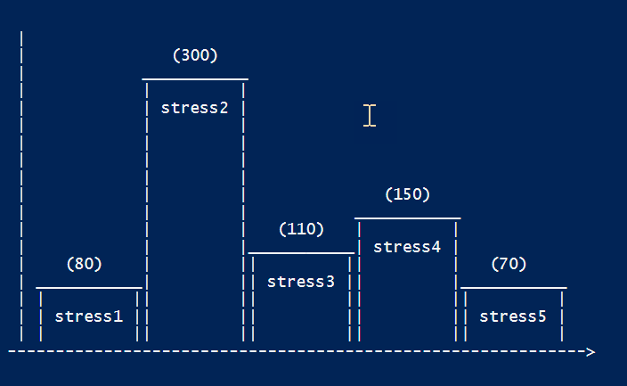
Retro
Just kidding of course ☺
We can do better nowadays

Slide 18
.Net Chart Controls
For ASP.Net pages or Windows Forms
PoshCharts by Boe Prox
Number of Out- cmdlets
No COM object
Work in progress
Community contributions welcome

Slide 19
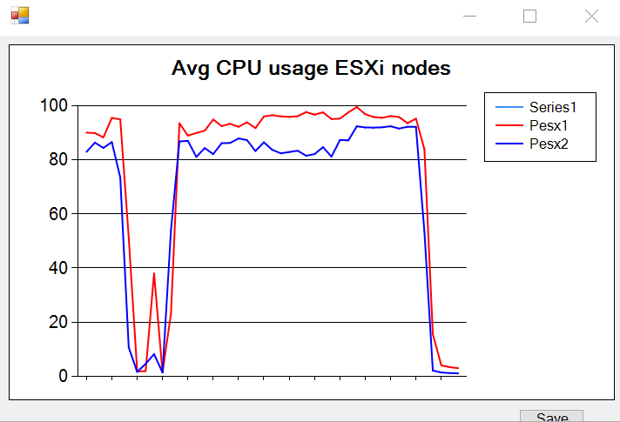
$extract1 = 'D:\Stats\extract1.csv'
$stat = 'cpu.usage.average'
Import-Csv -Path $extract1 -UseCulture |
Where{$_.Entity -match "^esx" -and
$_.MetricId -eq $stat -and
$_.Instance -eq ''} |
Sort-Object -Property Timestamp |
Group-Object -Property Timestamp |
Select Name,
@{N="Pesx1";E={$_.Group | where{$_.Entity -match "esx1"} |
select -ExpandProperty Value}},
@{N="Pesx2";E={$_.Group | where{$_.Entity -match "esx2"} |
select -ExpandProperty Value}} |
Out-LineChart -XField Name -YField1 Pesx1 -YField2 Pesx2 `
-Title 'Avg CPU usage ESXi nodes'

Slide 20
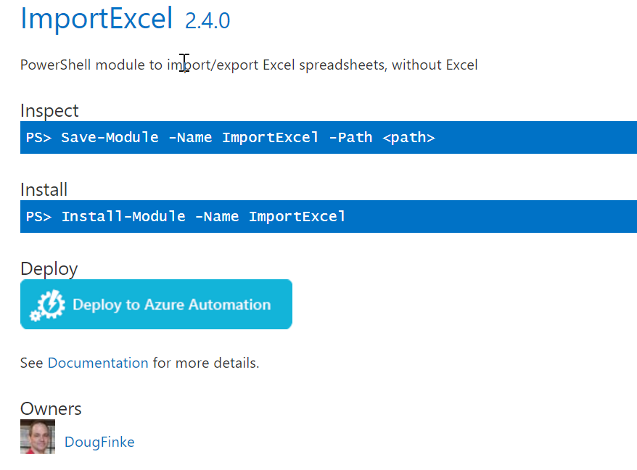
Excel
Doug Finke‘s ImportExcel
Does NOT require Excel to be installed
Don‘t bother with COM objects
Don‘t bother with counting cells

Slide 21
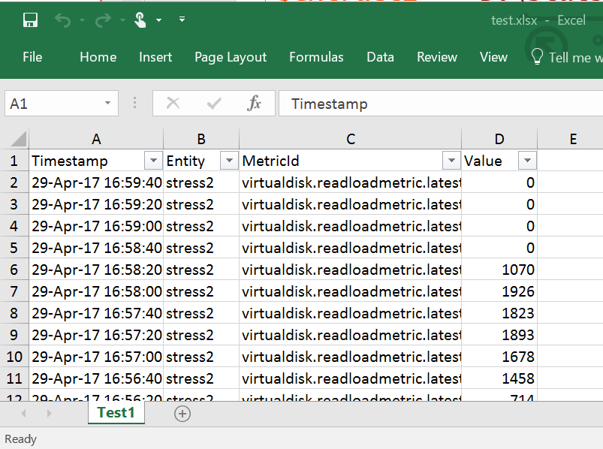
$extract1 = 'D:\Stats\extract1.csv'
$file = 'D:\Stats\test.xlsx'
Import-Csv -Path $extract1 -UseCulture |
Select -First 20 -Property Timestamp,Entity,MetricId,Value |
Export-Excel -Path $file -WorkSheetname Test1 `
-AutoSize -AutoFilter

Slide 22
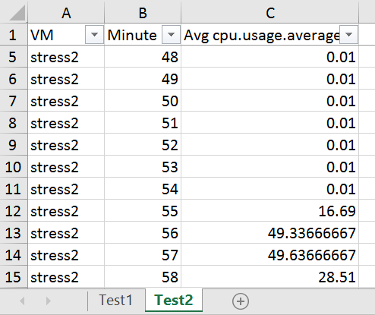
$extract1 = 'D:\Stats\extract1.csv'
$file = 'D:\Stats\test.xlsx'
$vmName = 'stress2'
$stat = 'cpu.usage.average'
Import-Csv -Path $extract1 -UseCulture |
where{$_.Entity -eq $vmName -and $_.MetricId -eq $stat} |
Group-Object -Property {([DateTime]$_.Timestamp).Minute} |
Sort-Object -Property Name |
Select @{N='VM';E={$vmName}},
@{N='Minute';E={$_.Name}},
@{N="Avg $($stat)";
E={$_.Group | Measure-Object -Property Value -Average|
select -ExpandProperty Average}} |
Export-Excel -Path $file -WorkSheetname Test2 `
-AutoSize -AutoFilter -FreezeTopRow

Slide 23
Excel
Still no pretty pictures ☹
We‘re getting there
... Just a matter of adding chart parameters
Chart is defined via New-ExcelChart cmdlet

Slide 24
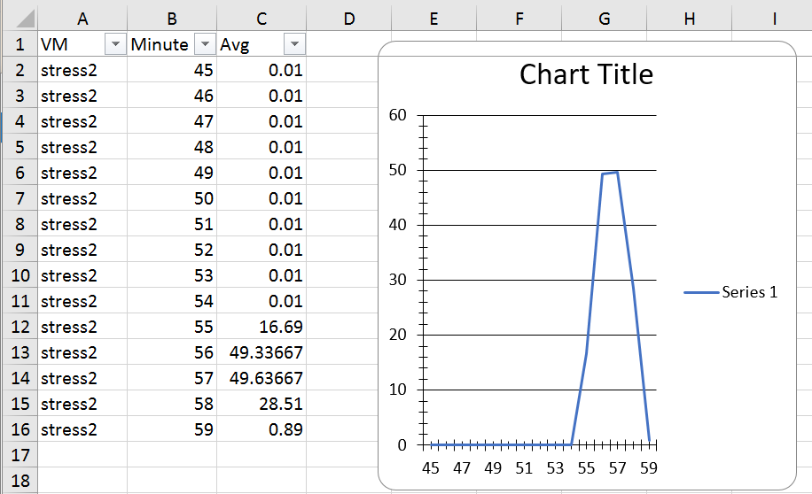
$extract1 = 'D:\Stats\extract1.csv'
$file = 'D:\Stats\test2.xlsx'
$vmName = 'stress2'
$stat = 'cpu.usage.average'
$chart = New-ExcelChart -XRange Minute -YRange Avg -ChartType Line
Import-Csv -Path $extract1 -UseCulture |
where{$_.Entity -eq $vmName -and $_.MetricId -eq $stat} |
Group-Object -Property {([DateTime]$_.Timestamp).Minute} |
Sort-Object -Property Name |
Select @{N='VM';E={$vmName}},
@{N='Minute';E={$_.Name}},
@{N="Avg";
E={$_.Group | Measure-Object -Property Value -Average|
select -ExpandProperty Average}} |
Export-Excel -Path $file -WorkSheetname Test3 `
-ExcelChartDefinition $chart -AutoNameRange `
-AutoSize -AutoFilter -FreezeTopRow

Slide 25
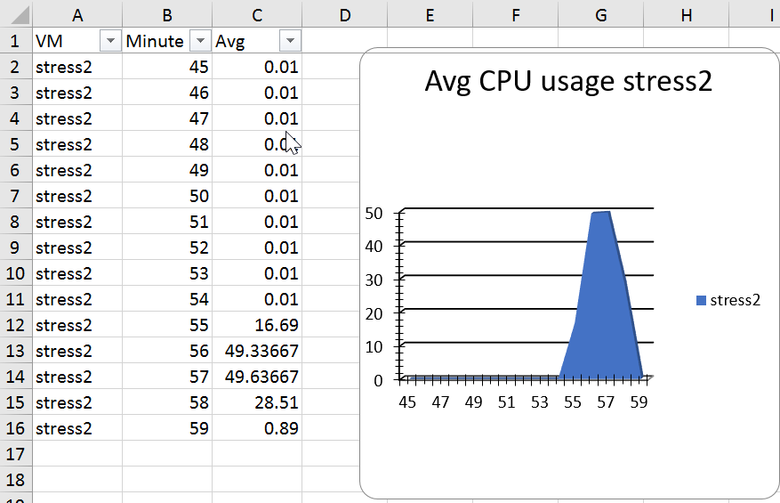
$sChart = @{
XRange = 'Minute'
YRange = 'Avg'
Title = "Avg CPU usage $($vmName)"
ChartType = 'Area3D'
SeriesHeader = "$($vmName)"
}
$chart = New-ExcelChart @sChart
Import-Csv -Path $extract1 -UseCulture |
where{$_.Entity -eq $vmName -and $_.MetricId -eq $stat} |
Group-Object -Property {([DateTime]$_.Timestamp).Minute} |
Sort-Object -Property Name |
Select @{N='VM';E={$vmName}},
@{N='Minute';E={$_.Name}},
@{N="Avg";
E={$_.Group | Measure-Object -Property Value -Average|
select -ExpandProperty Average}} |
Export-Excel -Path $file -WorkSheetname Test5 `
-ExcelChartDefinition $chart -AutoNameRange `
-AutoSize -AutoFilter -FreezeTopRow -Show

Slide 26
$extract1 = 'D:\Stats\extract1.csv'
$file = 'D:\Stats\test2.xlsx'
$vmName = "^stress"
$stat = 'cpu.usage.average'
$sChart = @{
XRange = 'Minute'
YRange = 'stress1','stress2','stress3','stress4','stress5'
Title = "Avg CPU usage"
ChartType = 'Line'
}
$chart = New-ExcelChart @sChart
Import-Csv -Path $extract1 -UseCulture |
where{$_.Entity -match $vmName -and $_.MetricId -eq $stat} |
Group-Object -Property {([DateTime]$_.Timestamp).Minute} |
Sort-Object -Property Name | %{
$obj = [ordered]@{
Minute = $_.Name
}
$_.Group | Group-Object -Property Entity |
Sort-Object -Property Name | %{
$avg = $_.Group |Measure-Object -Property Value -Average |
Select -ExpandProperty Average
$obj.Add($_.Name,$avg)
}
New-Object PSObject -Property $obj
} |
Export-Excel -Path $file -WorkSheetname Test6 `
-ExcelChartDefinition $chart -AutoNameRange `
-AutoSize -AutoFilter -FreezeTopRow -Show

Slide 27
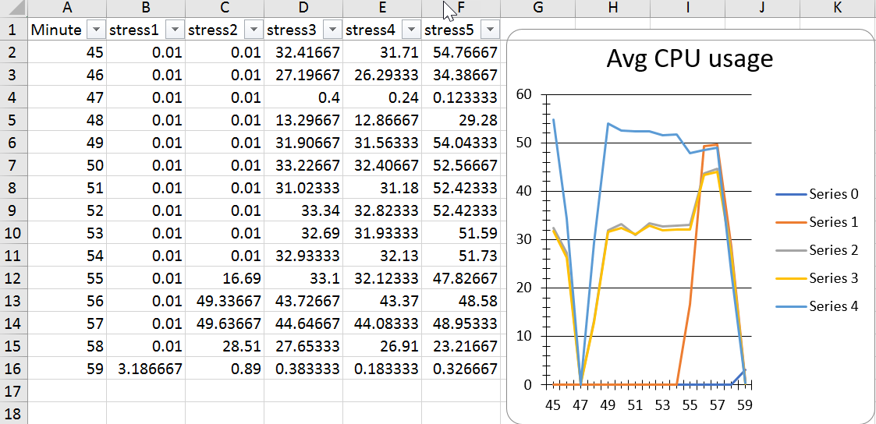

Slide 28
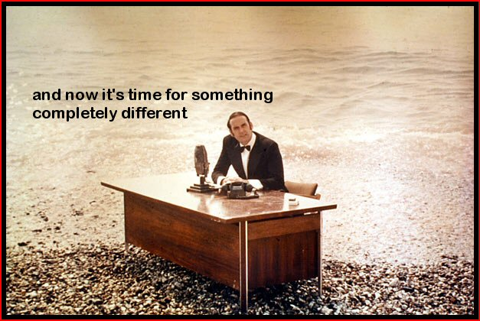

Slide 29
Containers
Growing up
Increasing number of containers available
Take away the tedious overhead
Just concentrate on the app(s)
… and how they (can) interact

Slide 30
Ad-hoc Perf
Most solutions will do
But… remote, sharing, ad-hoc
Containerised solution
To explore the possibilities ☺
Got hooked, wrote some functions
Photon as host
PowerShell/PowerCLI Core to automate
InfluxDB for data
Grafana for graphical interface

Slide 32
Principles of Operation
Problem reported, SBY called
Fire up the VM, deploy the containers
vSphere extraction scripts run in PowerCLI Core
Parameterised
Flushes data to InfluxDB
Grafana row templates
Create dashboard, optionally add rows
Access via http(s)

Slide 33
# Statistical data to InfluxDB
$dbName = 'vsphere'
$table = 'stats'
Remove-InfluxDB -DBName $dbName
New-InfluxDB -DBName $dbName
$start = [DateTime]"2017-04-29 16:45:00"
$finish = [DateTime]"2017-04-29 17:00:00"
$sFLux = @{
DBName = $dbName
Measurement = $table
Start = $start
Finish = $finish
}
Import-InfluxDB @sFlux

Slide 34
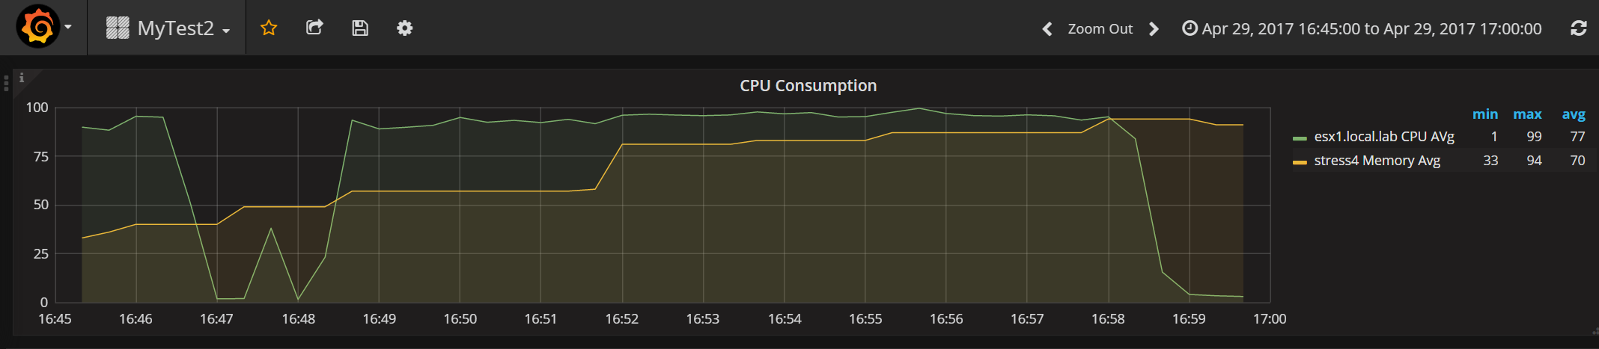
# Create Grafana dashboard from template
$sGraf = @{
Name = 'MyTest2'
Template = 'D:\Stats\MyDashBoard1.xml'
}
New-GrafanaDashBoard @sGraf

Slide 35
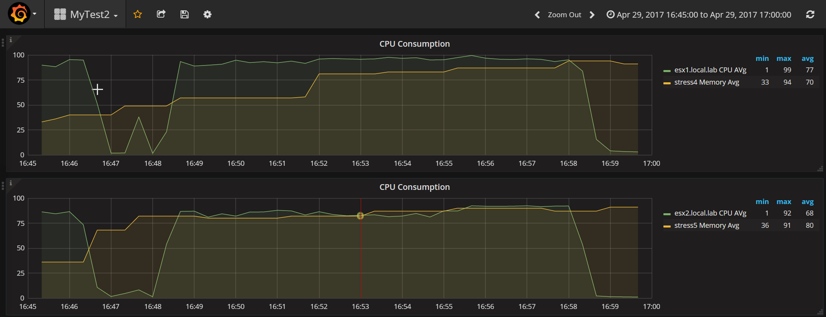
# Add a row on dashboard
$sGraf = @{
Dashboard = 'MyTest2'
Template = 'D:\Stats\MyDashBoard1.xml'
EsxName = 'esx2.local.lab'
VMName = 'stress5'
}
New-GrafanaDBRow @sGraf

Slide 36
Next <Container> Steps
Module?
Templates
Export
From scratch
Triggers
vSphere Alarms
SNMP trap
Slack robot

Slide 37
Summary
Graphs are good looking and great assistants
PowerShell has the power to handle your data
Pick a solution, automate it
Containers ftw!
Disclaimer
We only scratched the surface!

Slide 38
Next Steps...
Now: 15 min break
Grab a coffee
Stay here to enjoy next presentation
Change track and switch to another room
Ask me questions or meet me in a breakout session room afterwards

Slide 39
Questions?

Slide 40



About_Author
Luc Dekens
Belgium (the Flemish part)
Virtualisation ➔ PowerShell/PowerCLI ➔ SDDC ➔ DSC
PowerCLI Reference 1 ed & 2 ed
VMTN Community LucD
Blog LucD.info
Twitter @LucD22

Slide 41
2018
psconf.eu 2018
scheduled to be in the week of
April 16-20, 2018
details on www.psconf.eu as they become available

